Slide 1
Transformers and Large Language Models
Introduction to Large Language Models

Slide 2
Language models
Remember the simple n-gram language model
Assigns probabilities to sequences of words
Generate text by sampling possible next words
Is trained on counts computed from lots of text
Large language models are similar and different:
Assigns probabilities to sequences of words
Generate text by sampling possible next words
Are trained by learning to guess the next word

Slide 3
Neural Large Language Models (LLMs)
Self-supervised learners
Take a text, remove a word
Use your neural model to guess what the word was
If the model is wrong, use stochastic gradient descent to make the model guess better next time
Advantages (?):
All we need is a lot of text (GPT3: 500 billion tokens)
(And a lot of compute)

Slide 4
LLMs are built out of transformers
Transformer: a specific kind of network architecture, like a fancier feedforward network, but based on attention
Notes:
D

Slide 5
A very approximate timeline
1990 Static Word Embeddings
2003 Neural Language Model
2008 Multi-Task Learning
2015 Attention
2017 Transformer
2018 Contextual Word Embeddings and Pretraining
2019 Prompting

Slide 6
A picture of a transformer language model

Slide 7
Transformers and Large Language Models
Introduction to Large Language Models

Slide 8
Transformers and Large Language Models
Attention

Slide 9
Instead of starting with the big picture
Let's consider the embeddings for an individual word from a particular layer

Slide 10

Problem with static embeddings (word2vec)
They are static! The embedding for a word doesn't reflect how its meaning changes in context.
The chicken didn't cross the street because it was too tired
What is the meaning represented in the static embedding for "it"?
Notes:
D

Slide 11
Contextual Embeddings
Intuition: a representation of meaning of a word should be different in different contexts!
Contextual Embedding: each word has a different vector that expresses different meanings depending on the surrounding words
How to compute contextual embeddings?
Attention

Slide 12
Contextual Embeddings
The chicken didn't cross the street because it
What should be the properties of "it"?
The chicken didn't cross the street because it was too tired
The chicken didn't cross the street because it was too trafficy
At this point in the sentence, it's probably referring to either the chicken or the street
Notes:
D

Slide 13
Intuition of attention
Build up the contextual embedding from a word by selectively integrating information from all the neighboring words
We say that a word "attends to" some neighboring words more than others

Slide 14
Intuition of attention:
test
Notes:
D

Slide 15
Attention definition
A mechanism for helping compute the embedding for a token by selectively attending to and integrating information from surrounding tokens (at the previous layer).
More formally: a method for doing a weighted sum of vectors.
Notes:
D

Slide 16
Attention is left-to-right

Slide 17
Simplified version of attention: a sum of prior words weighted by their similarity with the current word
Given a sequence of token embeddings:
x₁ x₂ x₃ x₄ x₅ x_{i}
Produce: a_{i} = a weighted sum of x₁ through x₅
Weighted by their similarity to x_{i}
Notes:
D

Slide 18
Intuition of attention:
test
x1 x2 x3 x4 x5 x6 x7 xi
Notes:
D

Slide 19
Intuition of attention:
query
test
x1 x2 x3 x4 x5 x6 x7 xi
values
Notes:
D

Slide 20
Attention
Actually it's slightly more complicated, but I won't get into that
High-level idea: instead of just having a query and a set of values, each embedding actually also has a key

Slide 21
Intuition of attention:
query
test
x1 x2 x3 x4 x5 x6 x7 xi
keys
k
k
k
k
k
k
k
values
v
v
v
v
v
v
v
Notes:
D

Slide 22
Summary
Attention is a method for enriching the representation of a token by incorporating contextual information
The result: the embedding for each word will be different in different contexts!
Contextual embeddings: a representation of word meaning in its context.

Slide 23
Transformers and Large Language Models
Attention

Slide 24
Transformers and Large Language Models
The rest of the transformer applied to language modeling

Slide 25
The transformer
Attention is just part of computing embeddings in a transformer.
Let's see more of the mechanism

Slide 26

Reminder: transformer language model

Slide 27
The residual stream: each token gets passed up and modified

Slide 28
We'll need nonlinearities, so a feedforward layer

Slide 29
A transformer is a stack of these blocks
Block 2
Block 1

Slide 30
Inputs

Slide 31
Language modeling head

Slide 32
The final transformer model

Slide 33
Transformers and Large Language Models
The rest of the transformer applied to language modeling

Slide 34
Large Language Models
Pretraining (and how to train transformers for language modeling)

Slide 35
Pretraining
The big idea that underlies all the amazing performance of language models
First pretrain a transformer model on enormous amounts of text
Then apply it to new tasks.

Slide 36
Intuition of language model training
We just train them to predict the next word!
Take a corpus of text
At each time step t
ask the model to predict the next word
train the model using gradient descent to minimize the error in this prediction

Slide 37
Intuition of language model training: loss
Same loss function: cross-entropy loss
We want the model to assign a high probability to true word w
= want loss to be high if the model assigns too low a probability to w
CE Loss: The negative log probability that the model assigns to the true next word w
If the model assigns too low a probability to w
We move the model weights in the direction that assigns a higher probability to w

Slide 38
Training a transformer language model

Slide 39
Pretraining Data: mostly from the web (Common Crawl)
The Pile:

Slide 40
What does a model learn from pretraining?
There are canines everywhere! One dog in the front room, and two dogs
It wasn't just big it was enormous
The author of "A Room of One's Own" is Virginia Woolf
The doctor told me that he
The square root of 4 is 2

Slide 41
Big idea
Text contains enormous amounts of knowledge
Pretraining on lots of text with all that knowledge is what gives language models their ability to do so much

Slide 42
Large Language Models
Pretraining (and how to train transformers for language modeling)

Slide 43
Large Language Models
Large Language Models: Applying pretrained models to new tasks

Slide 44
Big idea
Many tasks can be turned into tasks of predicting words!

Slide 45
Three architectures for large language models
Decoders Encoders Encoder-decoders
GPT, Claude, BERT family, Flan-T5, Whisper
Llama 2 HuBERT
Mixtral

Slide 46
Decoders
Also called:
Causal LLMs
Autoregressive LLMs
Left-to-right LLMs
Predict words left to right

Slide 47
Conditional Generation: Generating text conditioned on previous text!
Notes:
D

Slide 48
Framing lots of tasks as conditional generation
Sentiment analysis: “I like Jackie Chan”
We give the language model this string: The sentiment of the sentence "I like Jackie Chan" is:
And see what word it thinks comes next:

Slide 49
Framing lots of tasks as conditional generation
QA: “Who wrote The Origin of Species”
We give the language model this string:
And see what word it thinks comes next:

Slide 50
Encoders
Many varieties!
Popular: Masked Language Models (MLMs)
BERT family
Trained by predicting words from surrounding words on both sides
Are usually fine-tuned (trained on supervised data) for classification tasks.

Slide 51
Encoder-Decoders
Trained to map from one sequence to another
Very popular for:
machine translation (map from one language to another)
speech recognition (map from acoustics to words)

Slide 52
Many more things I didn't talk about
Instruction Fine-tuning
Preference Alignment
Prompt Engineering
Where to learn these? CS224N!

Slide 53
Large Language Models
Large Language Models: Applying pretrained models to new tasks

Slide 54
Large Language Models
Harms of Large Language Models

Slide 55

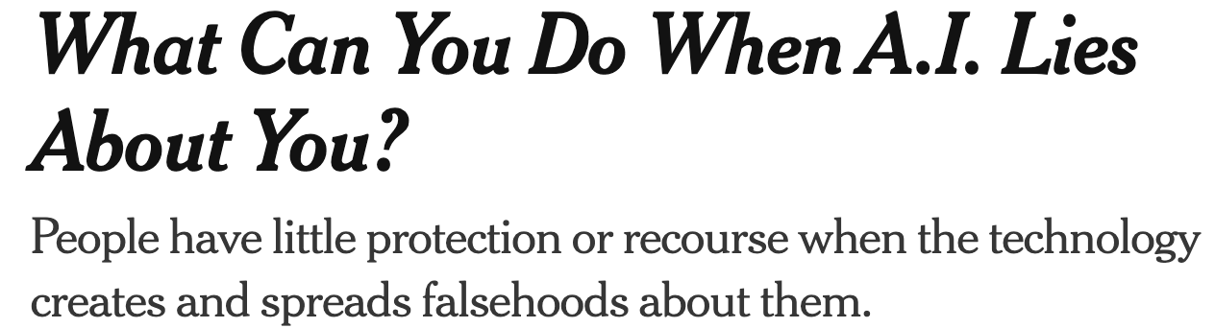

Hallucination
Notes:
LLMs make stuff up!

Slide 56
Current research direction to address hallucination
Retrieval-Augmented Generation (RAG)
Use information retrieval to retrieve some passages from a high-quality source
Then use a language model to generate an answer from those passages

Slide 57
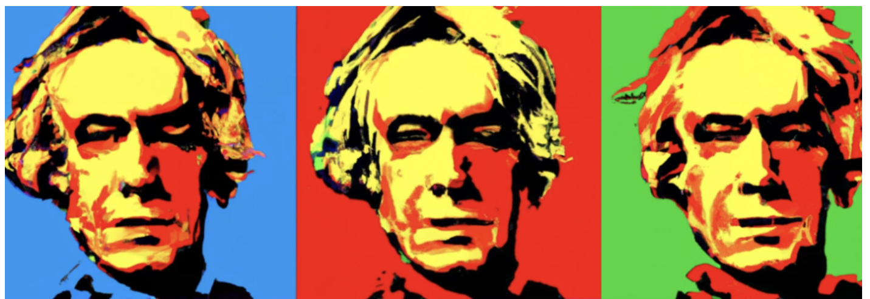

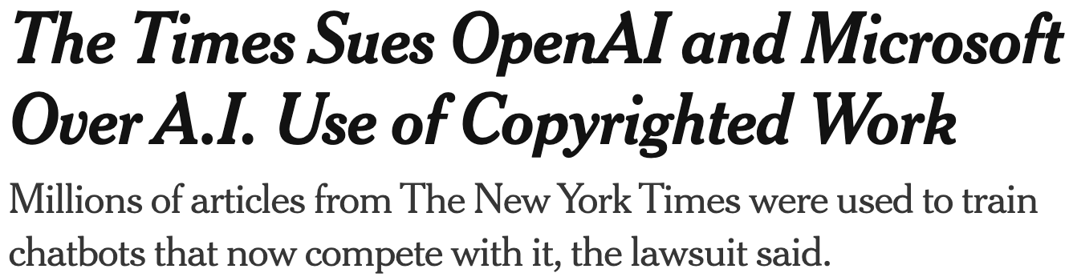

Copyright
Notes:
Who owns all that data that we trained the models on?

Slide 58
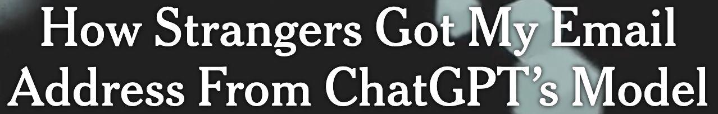
Privacy
Notes:
Training data can be leaked

Slide 59

Toxicity and Abuse

Slide 60

Misinformation

Slide 61
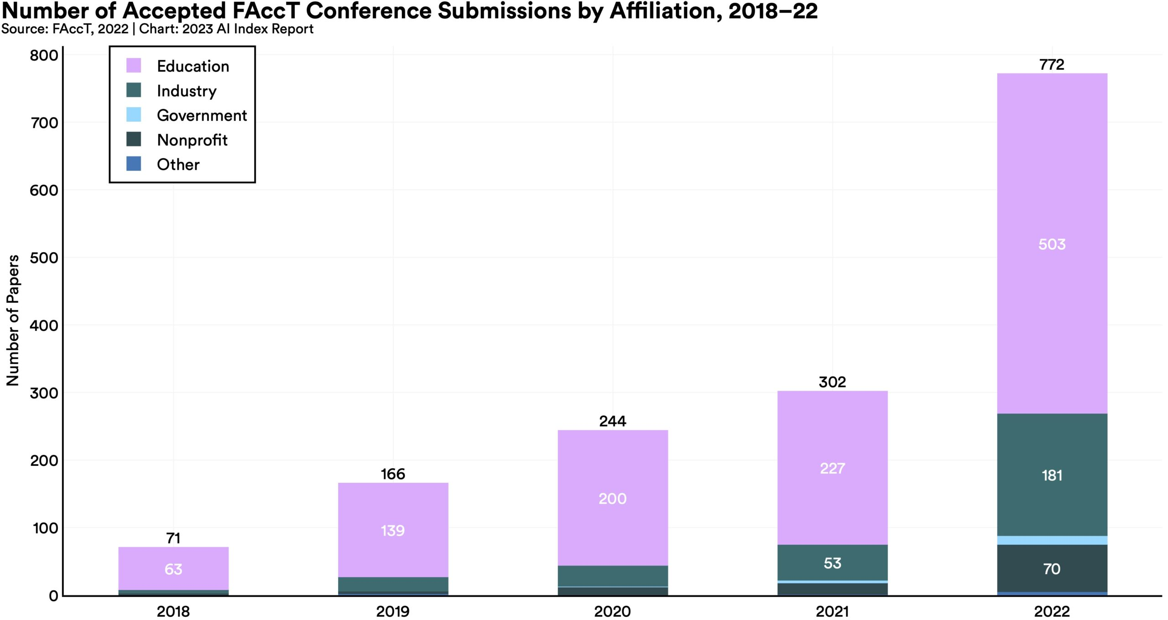
Vast growth in interest in Ethics of LLMs and AI
HAI: AI Index 2023

Slide 62
Large Language Models
Harms of Large Language Models

Slide 63
Large Language Models
Our last class together!

Slide 64
Learning goals
Write regular expressions for text tasks
Apply the edit distance algorithm
Build a supervised classifier
Build a search engine
Work with neural word embeddings
Train a neural network
Build a recommendation engine
Build a chatbot
Prompt a large language model

Slide 65
What's next? Spring 2024 NLP adjacent courses
CS224N: Natural Language Processing with Deep Learning (Chris Manning)
Algorithmic internals: transformers, GPT, parsing, machine translation and other applications. More of the gory details! More math, more machine learning
CS224C: NLP for Computational Social Science (Diyi Yang)
…machine learning and theories from social science to study human behaviors and important societal questions at scale. NLP, social networks, causal inference, application to social topics like hate speech, misinformation, and social movements.
CS 224S: Spoken Language Processing: (Andrew Maas)
Introduction to spoken language technology with an emphasis on dialogue and conversational systems.
CS 336: Language Modeling from Scratch (Tatsu Hashimoto and Percy Liang)
every aspect of language model creation, including data collection and cleansing for pre-training, transformer model construction, model training, and evaluation before deployment. Application required.
CS 246: Mining Massive Data Sets (Jure Leskovec)

Slide 66
Next year courses!
CS 224V: Conversational Virtual Assistants with Deep Learning (Monica Lam)
Topics include: (1) growing LLMs' knowledge, (2) stopping LLMs from hallucination (3) experimentation and evaluation of conversational assistants based on LLMs, (5) controlling LLMs to achieve tasks, (6) persuasive LLMs, (7) multilingual assistants, and (8) combining voice and graphical interfaces.
CS329X Human Centered NLP) (Diyi Yang)
human-centered design thinking in NLP, human-in-the-loop algorithms, fairness, and accessibility.
CS329R Race and NLP (Dan Jurafsky and Jennifer Eberhardt)
Integrate methods from natural language processing with social psychological perspectives on race to build practical systems that address significant societal issues

Slide 67
Fun courses outside of CS
Spring:
Linguist 173: Invented Languages
Linguist 134A: The Structure of Discourse
Linguist 156: Language, Gender, and Sexuality
COMM 154: The Politics of Algorithms
Next year:
Linguistics 150: Language and Society
Linguistics 130a: Introduction to semantics & pragmatics

